Slide 1
LECTURE -8(a)
Regression Analysis
Course Instructor
Engr. Naina Said

Slide 2
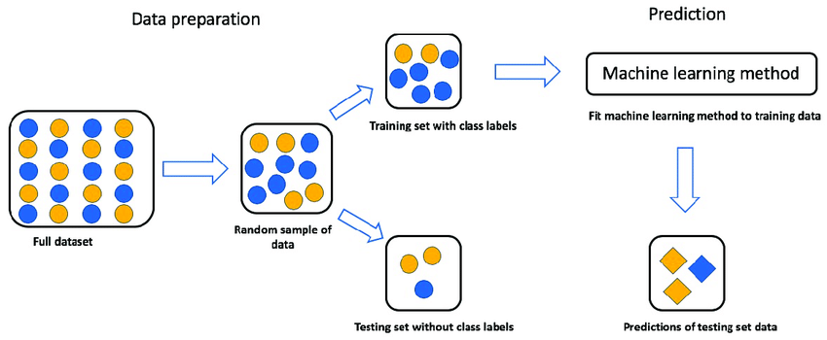
CSE-422: Data Analytics
ML Problems Flow

Slide 3
CSE-422: Data Analytics
ML Problems Flow
In order to make predictions, we first need a function which maps the input x to output y.
How we find the function depends on the algorithm.

Slide 4
CSE-422: Data Analytics
Equation of Straight Line Recap

Slide 5
CSE-422: Data Analytics
Linear Regression
Regression uses one or more explanatory variables (x) to predict one continuous response variable (y).
It uses a straight line to predict the response variable using the explanatory variable.
Used both in traditional statistics and ML.
Two type of regression
Simple Linear Regression.
Multiple/Multivariate Linear Regression.

Slide 6
CSE-422: Data Analytics
Simple Linear Regression

Slide 7
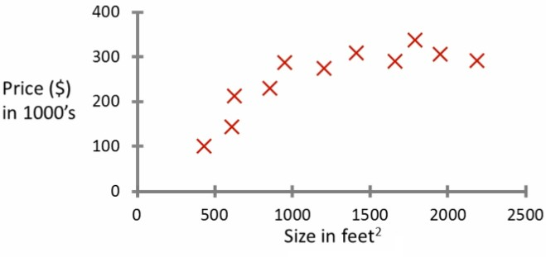
CSE-422: Data Analytics
Simple Linear Regression
Uses only one explanatory variable to predict the response variable.
Probably the most common problem type in Statistics/ML
Example : Predicting House Price

Slide 8
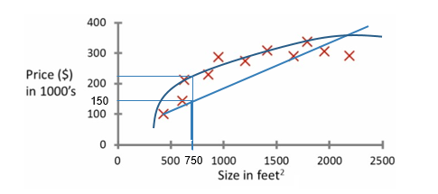
CSE-422: Data Analytics
Simple Linear Regression
What is the price of a house whose size is 750 sq. feet?

Slide 9
CSE-422: Data Analytics
Simple Linear Regression
Training set for house prices
Size in feet² (x) Price ($) in 1000’s (y)
2104 | 460
1416 | 232
1534 | 315
852 | 178
…. | ….

Slide 10
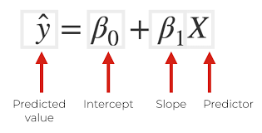
CSE-422: Data Analytics
Notations
Linear Regression is usually represented as

Slide 11
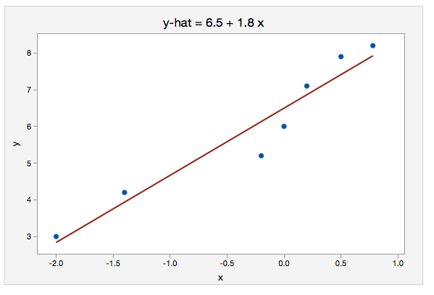
CSE-422: Data Analytics
Interpreting the Equation

Slide 12
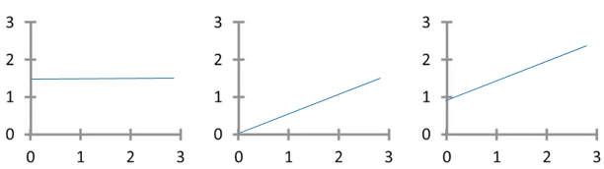
CSE-422: Data Analytics
Example
B0 = 1.5
B1 = 0
B0 = 0
B1 = 0.5
B0 = 1
B1 = 0.5

Slide 13
CSE-422: Data Analytics
Finding the Best Fit Line
Simple linear regression uses data from a sample to construct the line of best fit.
But what makes a line “best fit”?
The most common method of constructing a regression line is least squares method.
The least squares method computes the values of the intercept and slope that make the sum of the squared residuals as small as possible.

Slide 14
CSE-422: Data Analytics
Residuals
The predictions made by the SLR model are not perfect and always has some error.
If we are using height to predict weight, we wouldn't expect to be able to perfectly predict every individuals weight using their height.
These errors in regression predictions are called prediction error or residuals.
Least Square Method creates a best fit line that has the least amount of error.

Slide 15
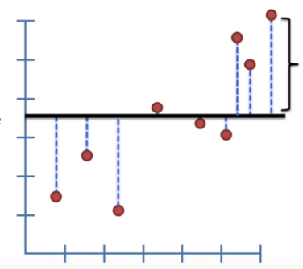
CSE-422: Data Analytics
Residuals
Distance from line to the data points is called the residuals.

Slide 16


CSE-422: Data Analytics
Residuals Formula
Residual
Sum of Squared Residuals

Slide 17
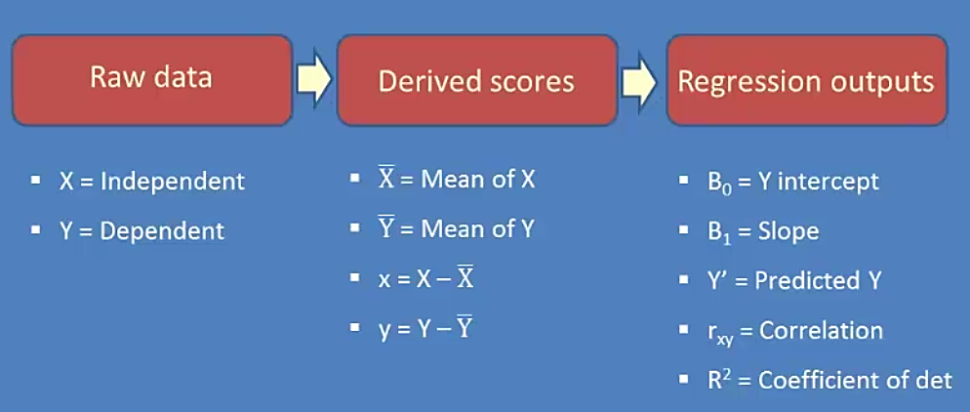
CSE-422: Data Analytics
SLR Summary

Slide 18
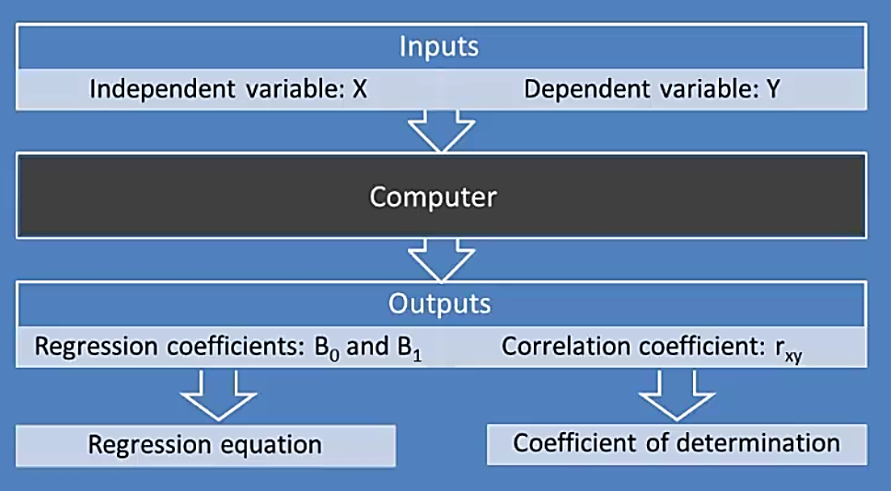
CSE-422: Data Analytics
SLR Analysis Flowchart
What happens inside the black box (computer)?

Slide 19
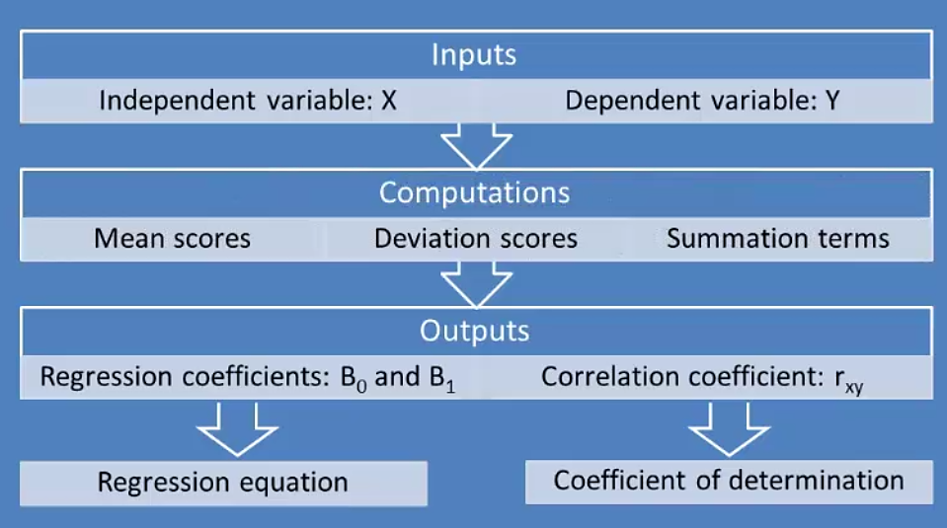
CSE-422: Data Analytics
Inside the Black Box

Slide 20
CSE-422: Data Analytics
Example
5 randomly selected students took a statistics exam before they could begin their machine learning course (scores shown on next slide)
We want to answer the following questions.
What linear regression equation best predicts ML course performance, based on statistics scores?
How well does the regression equation fit the data?
If a student made an 80 in the stats course, what grade would we expect him to make in ML?

Slide 21
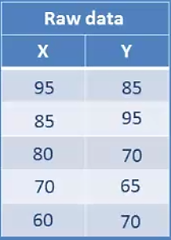
CSE-422: Data Analytics
Example
X = scores in Statistics
Y= scores in ML

Slide 22
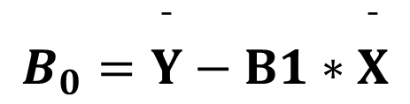


CSE-422: Data Analytics
Solution (a)
We want to find the regression equation
$$Y^{′}=B_{0}+B_{1}X$$
Where
$$B_{0}=\overset{¯}{Y}−B1∗\overset{¯}{X}$$
$$B_{1}=Σxy/Σx^{2}$$
Note that the lower case x,y is the deviation of X,Y (scores) respectively.

Slide 23
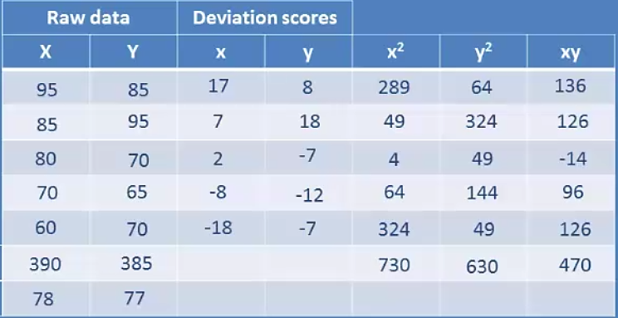
CSE-422: Data Analytics
Solution (a)
Sum
Mean

Slide 24
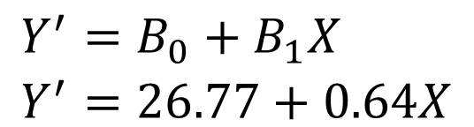
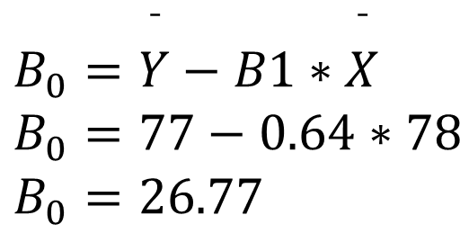
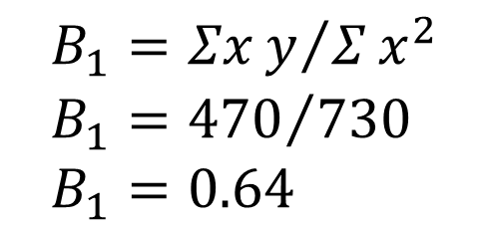
CSE-422: Data Analytics
Solution (a)
Calculating the coefficients
$$\begin{aligned}&B_{0}=\overset{¯}{Y}−B1∗\overset{¯}{X} \\ &B_{0}=77−0.64∗78 \\ &B_{0}=26.77\end{aligned}$$
$$\begin{aligned}B_{1}&=Σxy/Σx^{2} \\ B_{1}&={470}/{730} \\ B_{1}&=0.64\end{aligned}$$
Therefore, our linear regression equation is
But how well does this equation/line fits our data??
$$\begin{aligned}&Y^{′}=B_{0}+B_{1}X \\ &Y^{′}=26.77+0.64X\end{aligned}$$
Notes:
For every one unit change in stats marks, the ML marks are increased by 0.64 units.

Slide 25

CSE-422: Data Analytics
Coefficient of Determination R²
R² is the goodness of fit for your calculated linear regression equation/model.
R-squared gives you the percentage variation in y explained by x-variables
It Is calculated by squaring the correlation co-efficient of x and y.
If R² is close to 0, move on and don’t use regression.
If R² is significantly greater than 0, use regression.
$$R^{2}=r_{xy}^{2}$$

Slide 26
CSE-422: Data Analytics
Solution (b)
For our example, r_{xy} = 0.69
So, R² = 0.48.
The value is much greater than 0.
This suggests that our regression equation will provide us with useful predictions.

Slide 27
CSE-422: Data Analytics
Solution (c)
Given stats score 80, the scores in ML can be predicted by using our linear regression equation.
Y’=26.77+0.64(80)
Y’= 78.288
So if a student scores 80 in stats, he is expected to score 78.88 in ML as per our linear regression model.

